Slide 1

Fatigue and Dwell Fatigue studies on Ti-6242 and Ti-6246 Alloys
Presented by
Sharan Chandran
Under the guidance of
Prof. Dipankar Banerjee and Prof. Satyam Suwas
Department of Materials Engineering

Slide 2
Outline
Literature review
Introduction to titanium alloys
Phenomenological aspects of Dwell Fatigue
Damage initiation in Dwell fatigue
Motivation and objective
Current work
Modelling
Experiments
Summary and future work

Slide 3
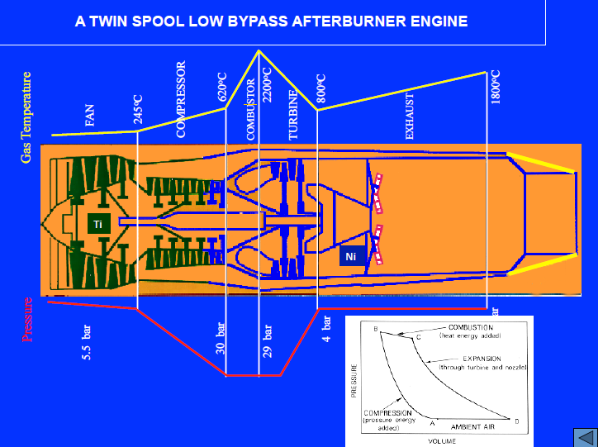
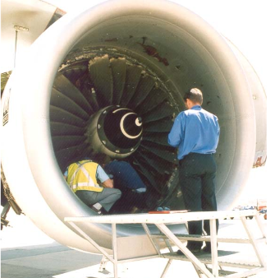
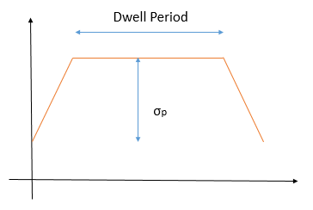


What is Dwell Fatigue ?
Ref: Wikipedia
Ref: Wikipedia
$$≠$$
Fig 1. Schematic of a typical flight cycle
M.R. Bache, International Journal of Fatigue, 2003

Slide 4
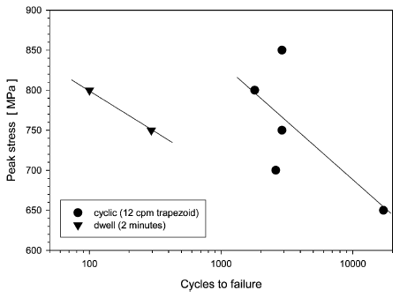
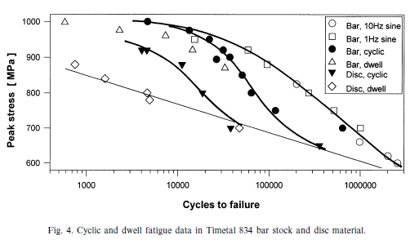
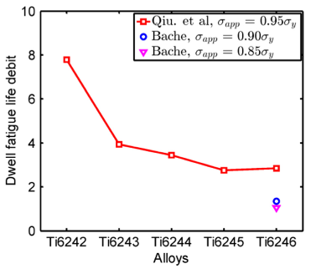

TIMETAL 685, 20°C
Accelerated tests are not possible
even though there is no corrosion
or heat generation issue.
But there is creep issue
TIMETAL 834, 20°C
Fig: DFD in two Ti alloys
W.J.Evans, 1998
Fig: DFD in two Ti alloys
W.J.Evans, 2001
Fig: DFD in some Ti alloys
F.P.E.Dunne, 2016
Why near alpha ?? In these applctins
DFD = $\frac{\text{No} \text{of} \text{cycles} \text{to} \text{failure} \text{in} \text{continuous} \text{cycling} }{\text{No} \text{of} \text{cycles} \text{to} \text{failure} \text{in} \text{Dwell} \text{loading}}$
=1 Dwell Insensitive
>10 Highly Sensitive
It is often called “COLD DWELL” in Titanium
α/near α Ti alloys such as Ti-6242, IMI 685, and IMI 834 are most susceptible
Increased DFD with peak load and dwell time

Slide 5
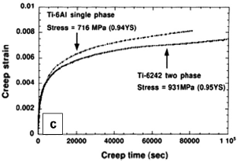
Fig: Perspectives on Titanium Science and Technology, D. Banerjee, et.al., 2014

Slide 6
Experimental Studies

Slide 7
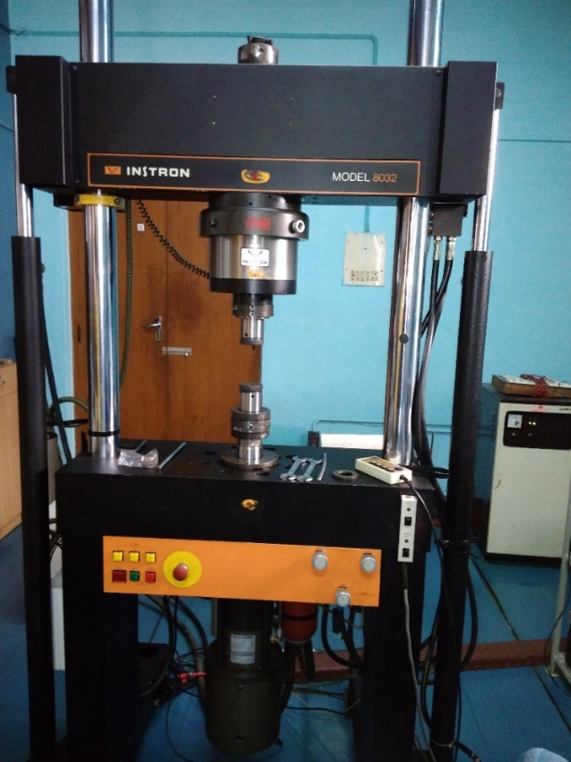
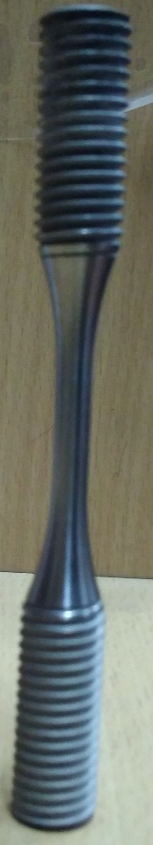
Dwell Fatigue Testing
Load Controlled Dwell Fatigue
test at RT
6mm
Surface is not very critical
in the case of dwell fatigue
as it is close to low cycle
fatigue
Vacuum Sealed and Heat treated to the desired condition
Normal fatigue
Dwell fatigue
Instron fatigue testing machine
100kN, Servo-hydraulic
Load for 0.95 proof
120 sec
Load
1s
1s
1s
Time

